Slide 1

Web APPLICATION Development (111834)
Dr. Owais Hussain

Slide 2

Agenda
Introduction to Django
Model-View-Template
Creating a Django project
Project Structure
Adding an App
Common Utility Commands

Slide 3
Sample 2
Introduction to Django
Django is a platform independent, open-source, Web Application Framework written in Python
Unlike Java, .NET, PHP frameworks, which use MVC pattern, Django uses MVT design pattern
On top is a Django project with one or more apps inside it
Has the following out of the box:
Object Relational Mapping
Authentication
URL Routing
Default Admin Interface

Slide 4
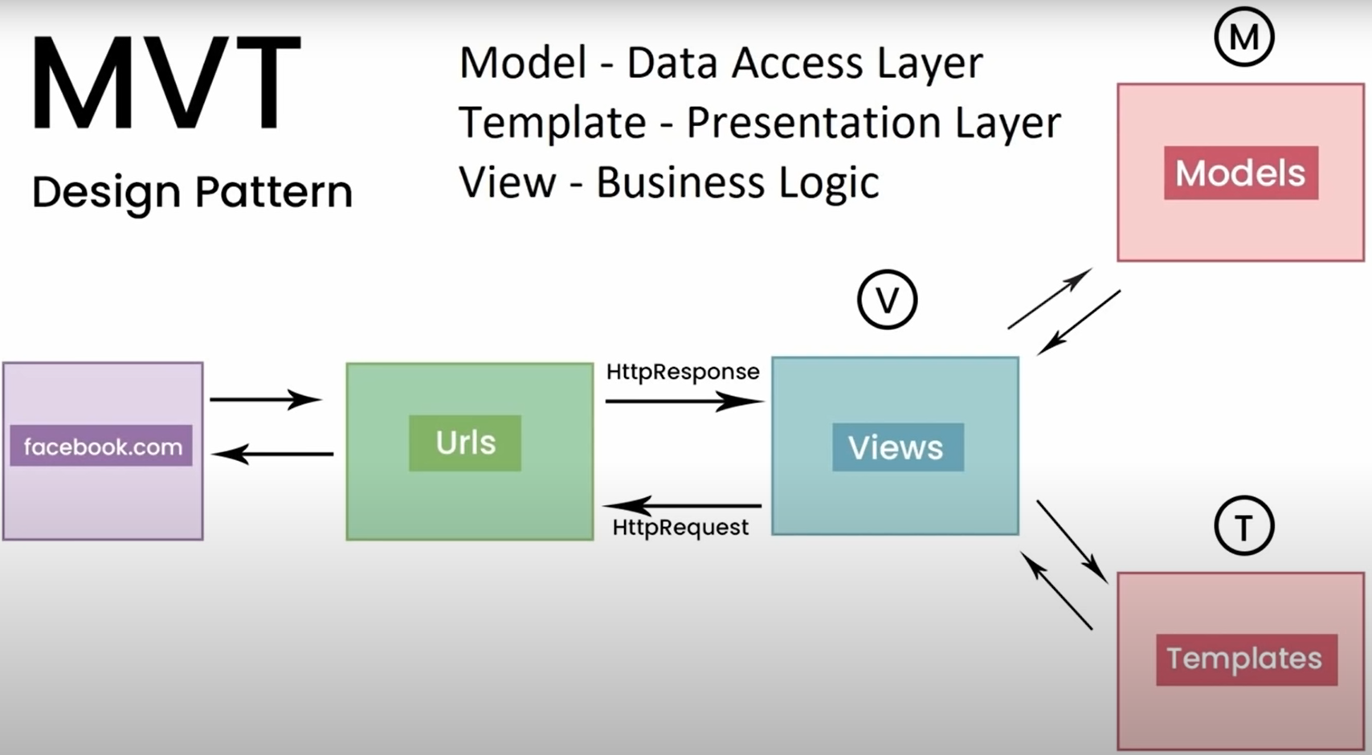
Sample 2

Slide 5
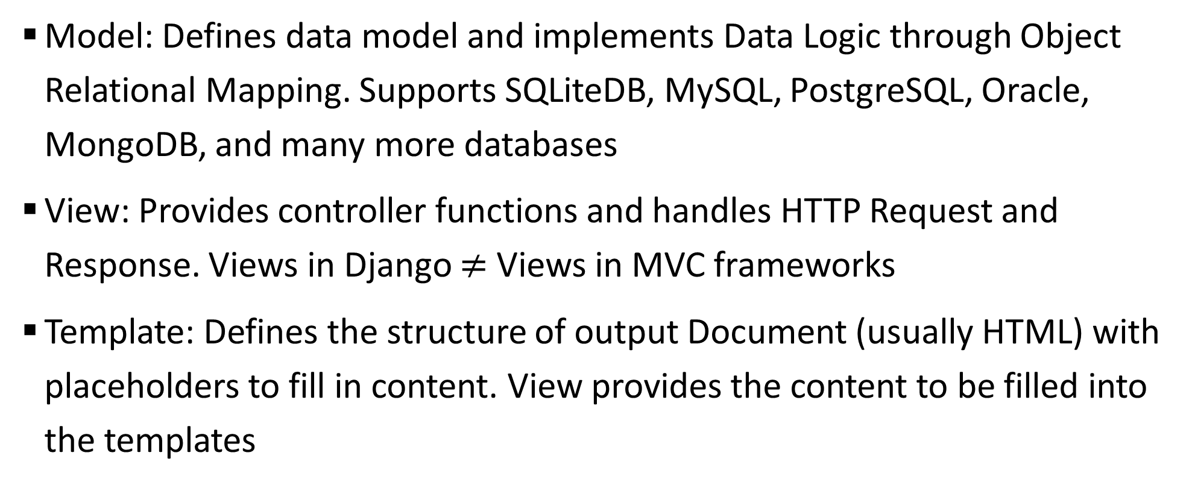
Sample 2
Model-View-Template
Model: Defines data model and implements Data Logic through Object Relational Mapping. Supports SQLiteDB, MySQL, PostgreSQL, Oracle, MongoDB, and many more databases
View: Provides controller functions and handles HTTP Request and Response. Views in Django $≠$ Views in MVC frameworks
Template: Defines the structure of output Document (usually HTML) with placeholders to fill in content. View provides the content to be filled into the templates

Slide 6
Sample 2
Creating a Django Project
You can use PyCharm (recommended), VS-Code, or any IDE of your choice.
Pre-requisites:
Install Python 3.8+
Create a virtual environment $python -m venv venv
Activate the environment $cd venv/Scripts $./activate.bat
Install Django $pip install django
Create a new project using Django admin utility (do NOT forget the dot) $django-admin startproject dareecha .

Slide 7
Sample 2
Project Structure
Django project is a base to create more than one applications and control from single entry point.
Settings module
URLs module
WSGI module
ASGI module

Slide 8
Sample 2
Adding an App
Let’s add a new application to our project
Create a new app inside the root directory using Django admin utility $django-admin startapp baham
Create a directory in baham called “static” to keep all static files
Create a directory in baham called “templates” to keep all HTML templates
Create a file named urls.py
Run using manage.py module $python manage.py runserver 8888

Slide 9
Sample 2
Assignment 3
Create your course project on Django and add an empty application.
Create a repository on Github for your project
Group leader should create the first repository
Other members should Fork from that repository
Create your Agile board on either Trello or Jira
Add initial documentation to the README file of your Django project and write your project idea there in detail.

Slide 10



THANK YOU
Owais Hussain
+92 345-3174270
owais.hussain@kiet.edu.pk
https://www.researchgate.net/profile/Owais-Hussain-3

